Slide 1
Computationally Efficient Neural Image Compression
2019, Nick Johnston et al., Google Research
arXiv preprint
20201002-魏梓泉

Slide 2
Contributions
Analyze the complexity of a common neural architecture’s decoder
Optimize Generalized Divisive Normalization (GDN, an activation function commonly used in neural image compression)[5] to reduce run-time at no performance loss.
Apply a regularization technique to optimize decoder architecture for Computationally Efﬁcient Neural Image Compression (CENIC) models.
Analyze the trade offs of these learned architectures with respect to rate–distortion performance.

Slide 3
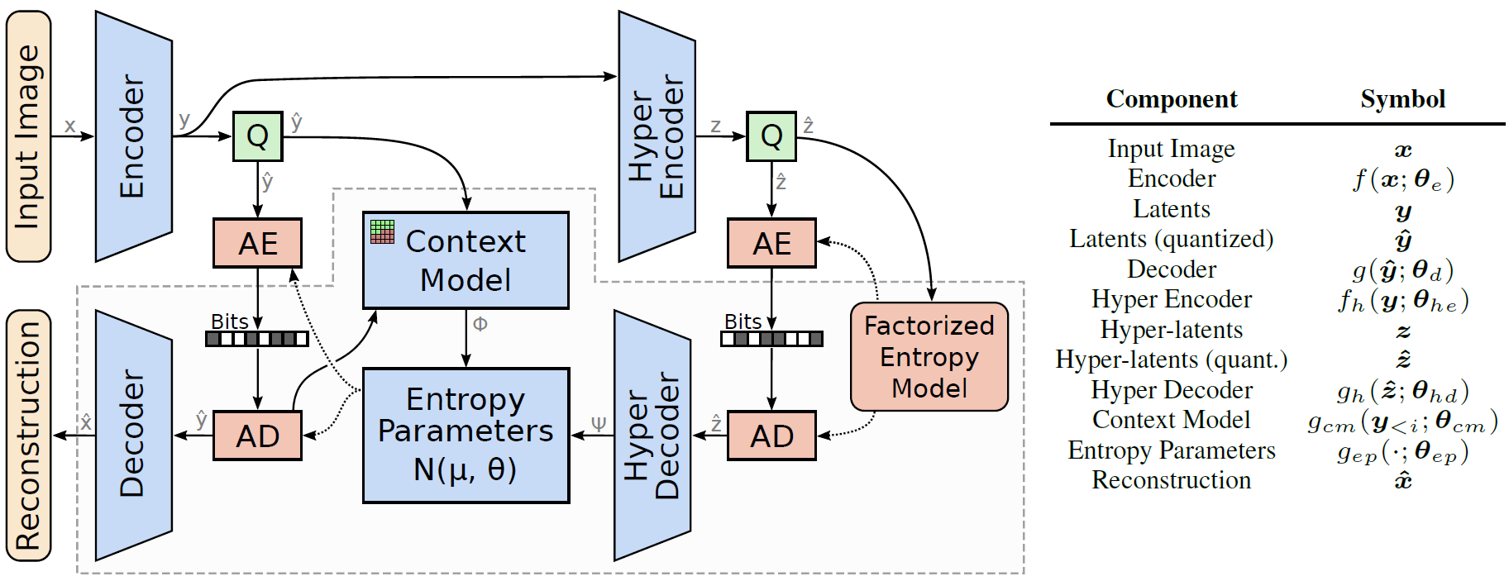
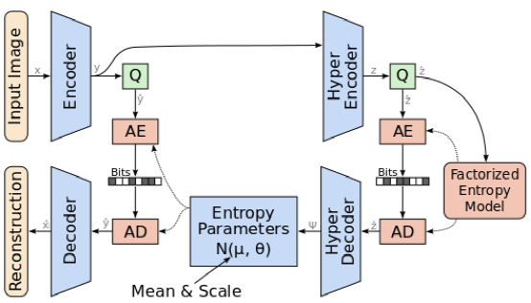


[1] Joint Autoregressive and Hierarchical Priors for Learned Image Compression. 2018 NIPS
Mean-Scale Architecture
Mean-Scale
Larger Mean-Scale

Slide 4
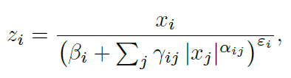
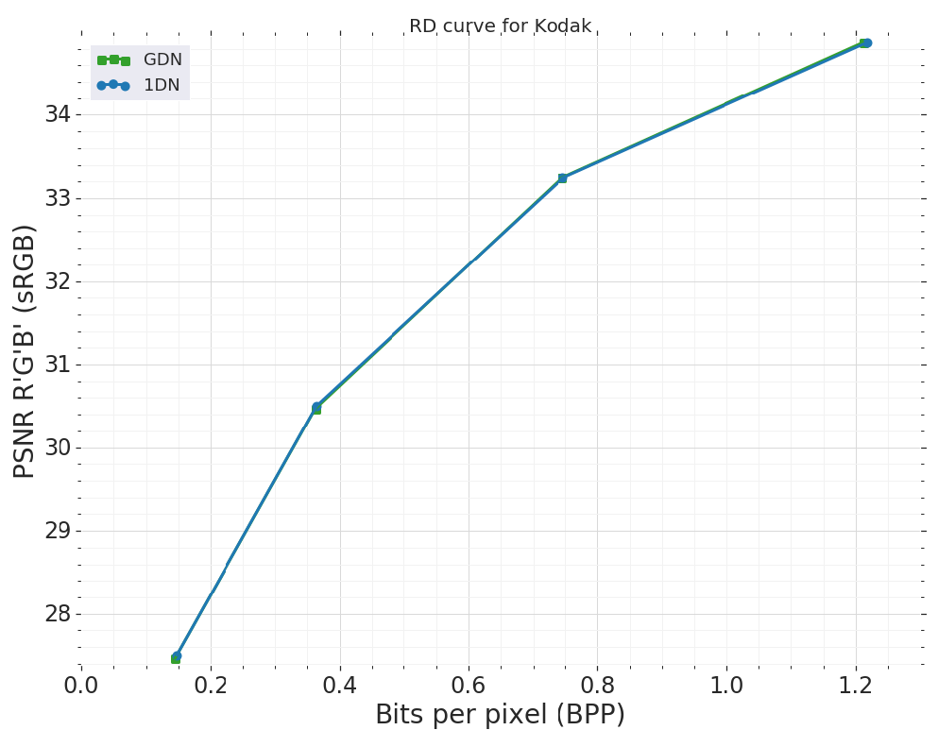

1DN Activation Function

Slide 5




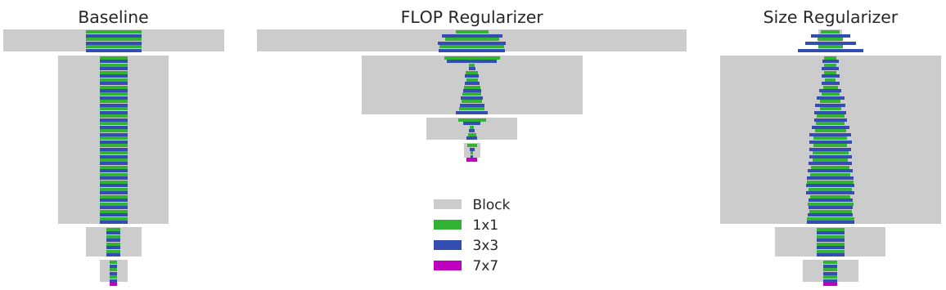
Group Lasso Regularization
MorphNet

Slide 6
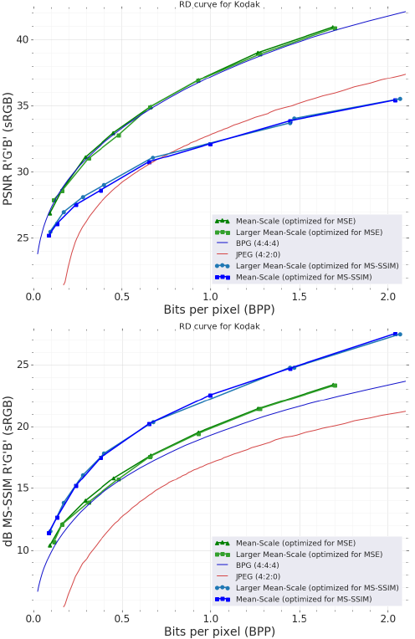
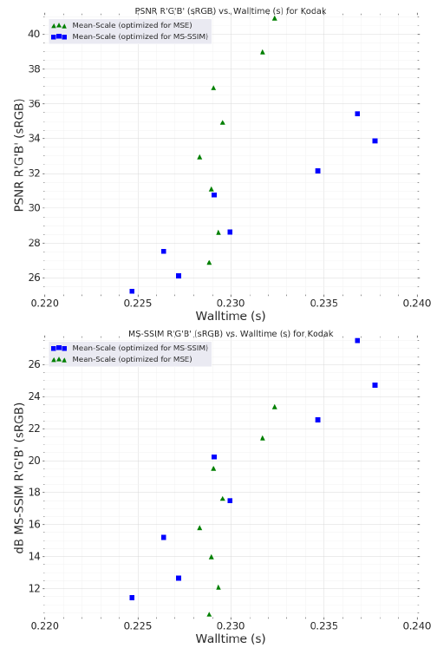
Results
the Mean-Scale model runs much faster on GPU. With the average CPU run-time being around 230 milliseconds and the average GPU run-time being around 62 milliseconds (a 3.7x speed-up).

Slide 7
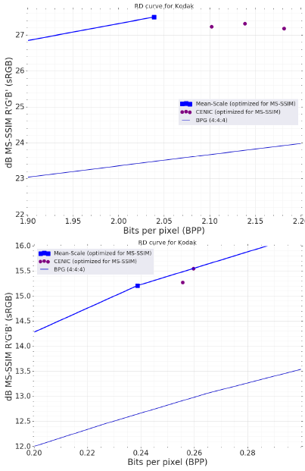
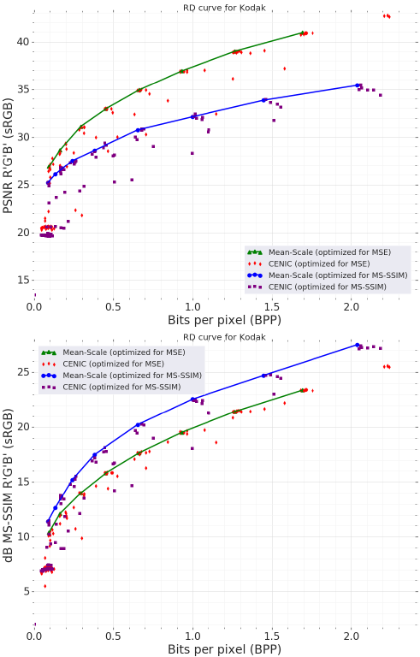
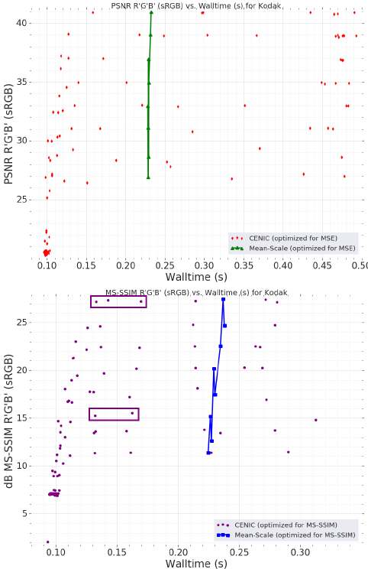
Results of CENIC

Slide 8
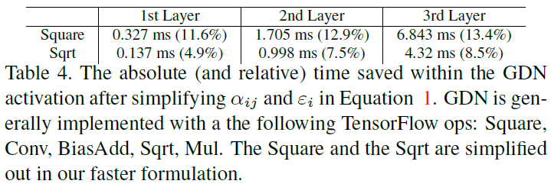
Results of 1DN
Overall, this results in a 14.33 ms reduction (21.4% savings) within the GDN operation and a 2.7% overall speed-up in the Mean-Scale models.

